Slide 1
ATM Machine Project
A project By:
SAKE TEAM (Team 2)
Mohamed Samy
Amr Mohamed
Kariman Karam
Mohamed Ehab

Slide 2
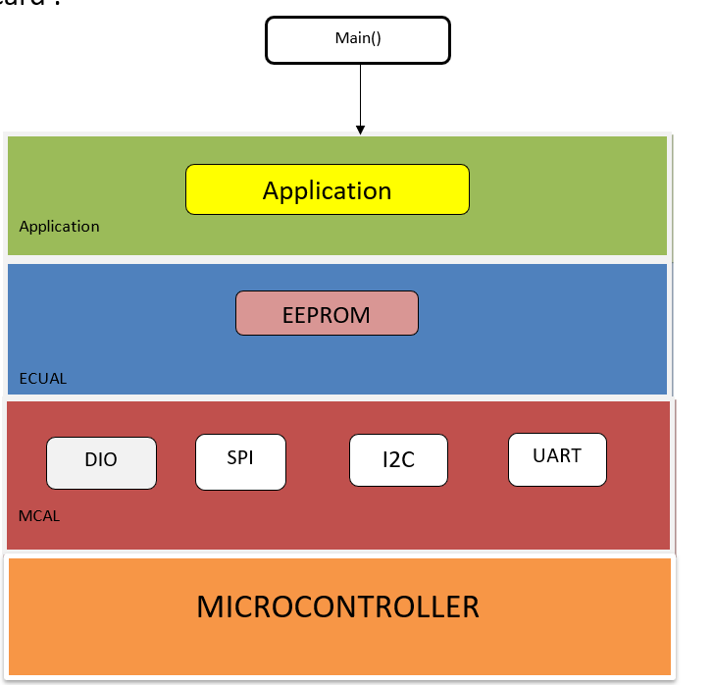
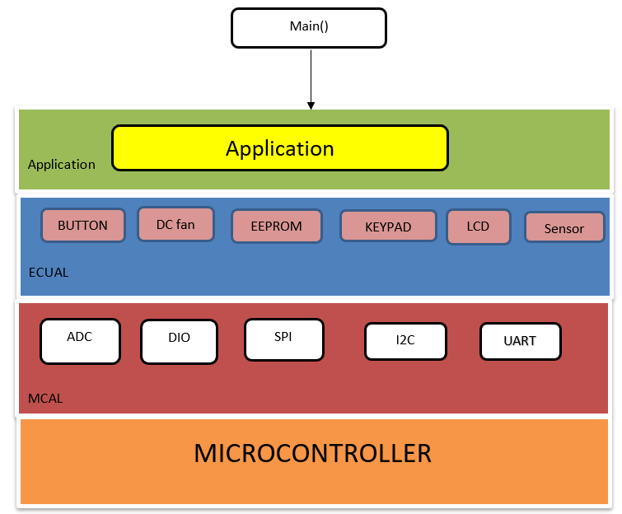
I) Static Design:.
CARD
ATM

Slide 3

ENUMS
Application Layer APIs:

Slide 4
ECUAL layer:
EEPROM APIs:

Slide 5
ECUAL layer:
Button APIs:
DC Fan APIs:

Slide 6
ECUAL layer:
Keypad APIs:
Temp Sensor APIs:

Slide 7
ECUAL layer:
LCD APIs:

Slide 8
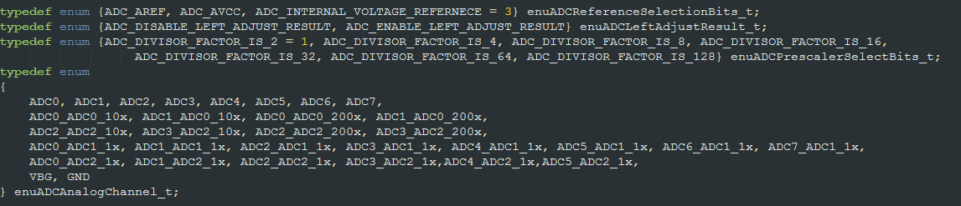
MCAL layer:
ADC APIs:

Slide 9
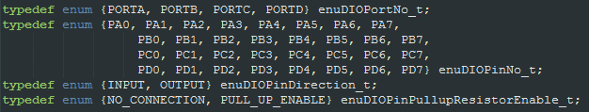
MCAL layer:
DIO APIs:

Slide 10

MCAL layer:
SPI APIs:

Slide 11
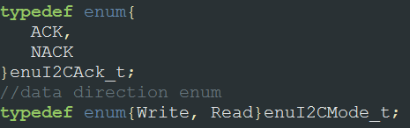

MCAL layer:
I2C (TWI) APIs:

Slide 12
MCAL layer:
I2C (TWI) APIs:

Slide 13
MCAL layer:
UART APIs:

Slide 14
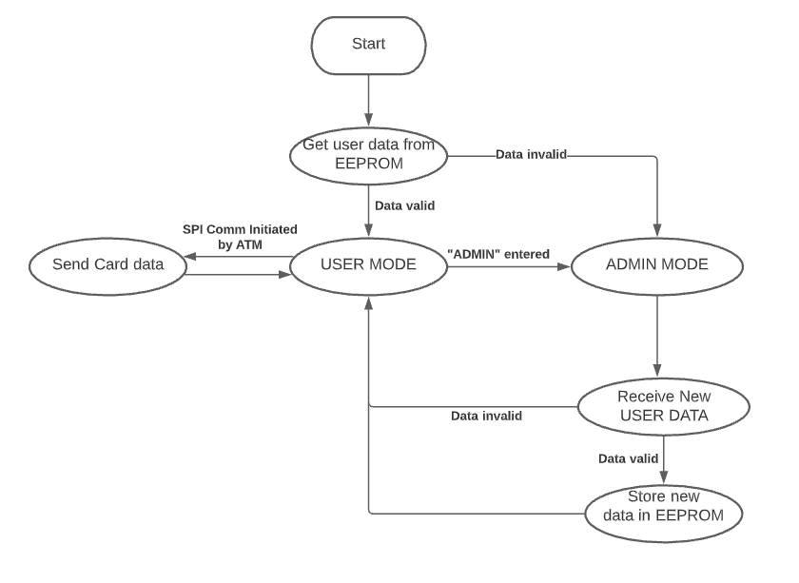
Application flow chart diagram:
Card App

Slide 15
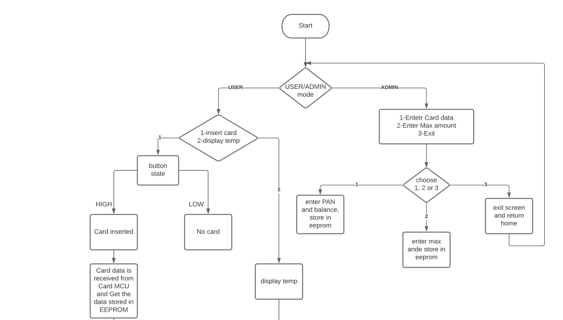
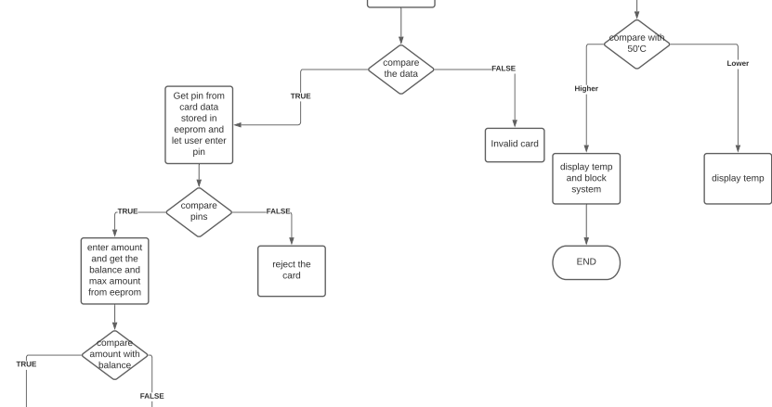
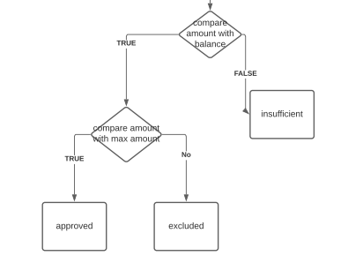
Application flow chart diagram:
ATM App

Slide 16
II) Tasks and Responsibilities:
DRIVERS:
Mohamed Samy : ADC , DIO , Keypad , LCD , DC fan , Motor , Sensor , Button
•Amr Mohamed : I2C , EEPROM
•Kariman Karam : SPI
•Mohamed Ehab : UART
Application Software:
•Card : Amr Mohamed •ATM : Mohamed Samy , Kariman Karam , Mohamed Ehab

Slide 17
II) Tasks and Responsibilities:
Hardware :
Mohamed Samy
Kariman Karam
Static Design :
Mohamed Ehab
Simulation Video :
Amr Mohamed

Slide 18
III) Time Estimate:
From July 29 to August 1

Slide 19
IV) Test Cases:
A) CARD Application:
TC ID | TEST CASE | EXPECTED OUTPUT | ACTUAL OUTPUT | Output
1 | - Initialize with empty/corrupted EEPROM Data | Go into programming mode and initialize EEPROM data | Card got into programming mode to initialize card PAN+PIN | PASS
2 | Initialize with valid EEPROM data Input “ADMIN” In Terminal | Go to admin screen and reinitialize PAN and PIN | Card got into programming mode to initialize card PAN+PIN | PASS
3 | - Initialize with valid EEPROM data - Enable SPI Communication | Send PAN+PIN frame over SPI | Card sent PAN+PIN Frame over SPI | PASS

Slide 20
IV) Test Cases:
B) ATM Application: (To be continued)
TC ID | TEST CASE | EXPECTED OUTPUT | ACTUAL OUTPUT | Output
1 | - Input “ADMIN” in terminal - Input invalid password | Returning “Invalid Password” on the terminal and ask for the used mode | “Invalid Password” returned on the terminal and asked about the used mode | PASS
2 | Initializing with valid EEPROM data but the PAN of the card is not stored in the EEPROM | Returning “Invalid card , card is ejected” on the LCD | “Invalid card , card is ejected” returned on the LCD and go to the first screen | PASS
3 | Initializing with valid EEPROM data and the PAN of the card is stored in the EEPROM but the user input incorrect PIN | Returning “Incorrect PIN, card is ejected” on the LCD | “Incorrect PIN, card is ejected” returned on the LCD and go to the first screen | PASS

Slide 21
IV) Test Cases:
B) ATM Application
TC ID | TEST CASE | EXPECTED OUTPUT | ACTUAL OUTPUT | Output
4 | Initializing with valid EEPROM data and the PAN of the card is stored in the EEPROM and the user input the PIN correctly but the user entered amount greater than the maximum amount | Returning “Maximum amount exceeded” on the LCD | “Maximum amount exceeded” returned on the LCD and go to the first screen | PASS
5 | Input invalid data but the user entered amount greater than the his balance | Returning “Insufficient fund” on the LCD | “Insufficient fund” returned on the LCD and go to the first screen | PASS
6 | Input invalid data but the user entered amount less than or equal to the his balance | Returning “Transaction approved” on the LCD | “Transaction approved” returned on the LCD and go to the first screen | PASS

